Slide 1


National Mining University: QA experience
Alekseyev M.A.
Chernyshenko V.
Churikanova E.
Us S.A.
4th of May 2016

Slide 2

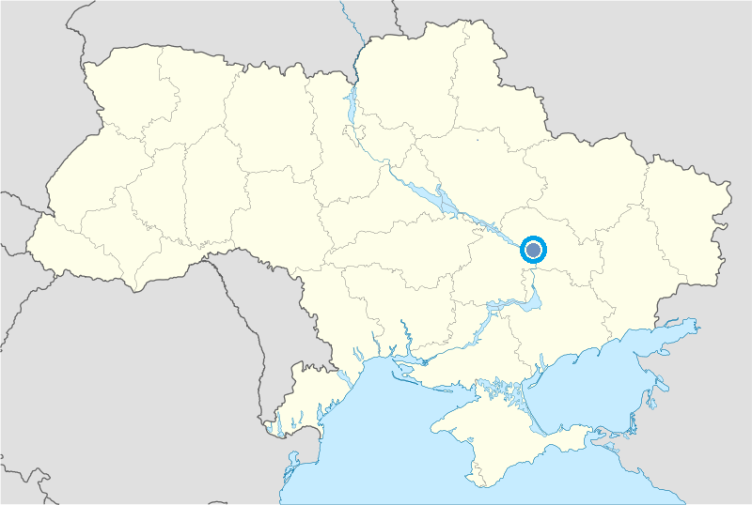
Dnipropetrovsk
One of the most important industrial, economical and transport centers of the Ukraine.
Capital of ferrous metallurgy and aerospace of the Ukraine.
Fourth largest city in the Ukraine.

Slide 3
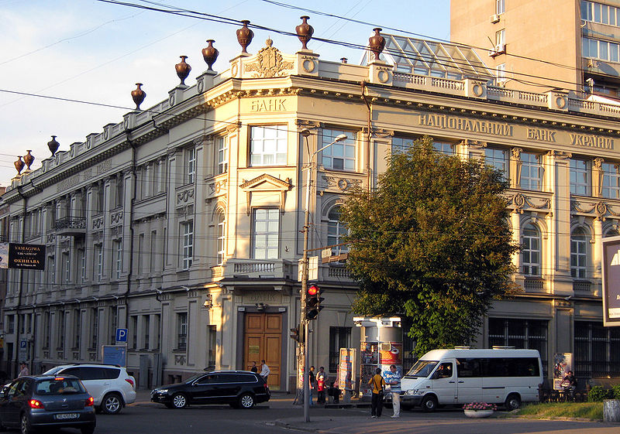



Dnipropetrovsk
Was based in 1787
Population is around 1 million of people

Slide 4




Dnipropetrovsk
There are 25 higher educational institutes
and 164 schools

Slide 5



Dnipropetrovsk
With more than 120 thousands of students
and 80 thousands pupils

Slide 6
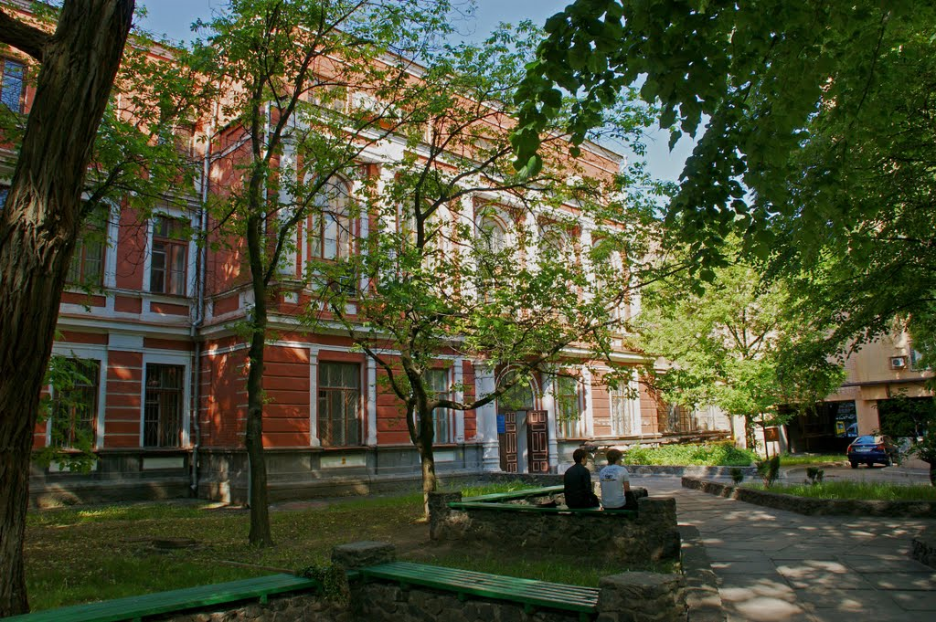
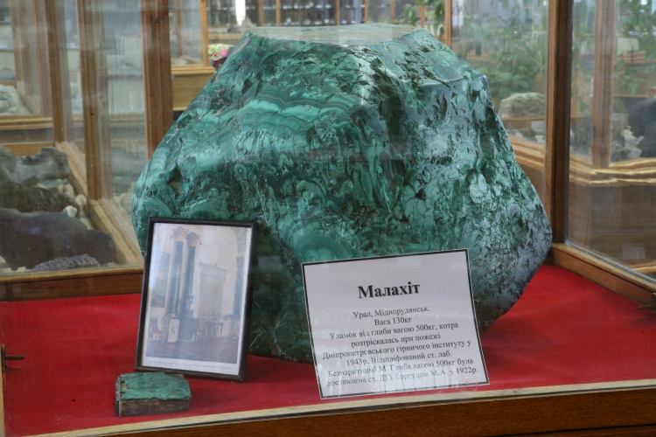

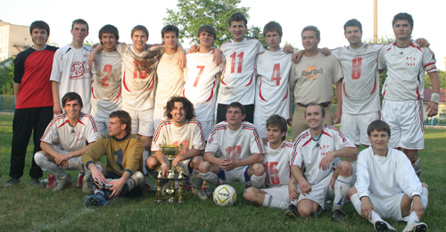
National Mining University

Slide 7
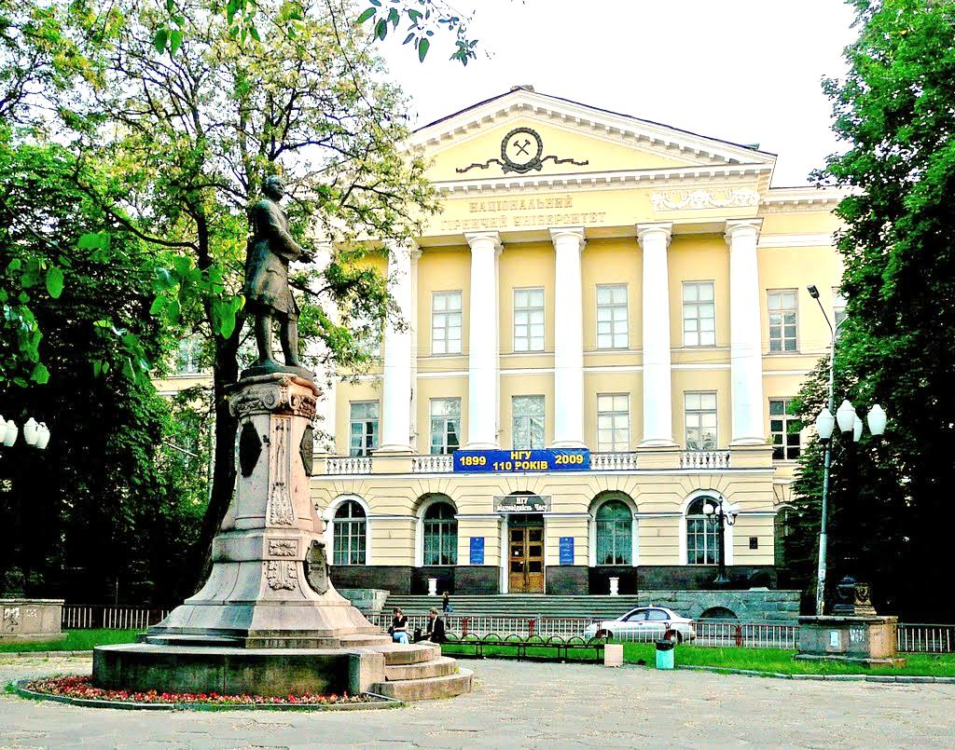
National Mining University
Students ≈14 000
Teachers 1064
Graduation specialties 53
Institutes 4
Faculties 9
Departments 52
Scientific councils 7
International partners 118

Slide 8
Merits & Strength
According to the national rating KOMPAS-2014 in Ukraine NMU takes:
4th place among technical universities.
7th place among higher educational institutes.
According to the UNESCO international rating in Ukraine:
3rd place among technical universities.
7th place among higher educational institutes.
According to both ratings NMU takes 1st place among higher educational institutes of the southern region of Ukraine

Slide 9
Merits & Strength
University has IV level of accreditation.
There were executed 65 research scientific works in the frames of governmental and business contracts in 2015.
There are 6 scientific educational centers that are engaged in solving actual problems of mining and energetics sectors.

Slide 10

Working group
Illustration by Hank Osuna, 2013

Slide 11

Manager:
Prof., Dr. Aleksieiev M.A.
Supervisor:
PhD, Dr. Chernyshenko V.
Workgroup:
PhD, dr. Us S.A. – external QA research
PhD, dr. Churikanova E. – internal QA research
PhD, dr. Koryashkina L.S.
PhD, dr. Udovik I.M.
7 volunteers students (software development)
NMU working group

Slide 12
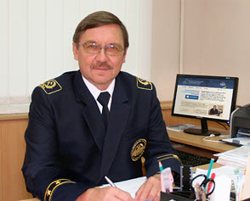
Taking part in formulation of the government standards of higher education
M. Alexieiev used to be:
member of the council of experts in computer science and technologies sphere of State Certification Commission of Ukraine.
member of the methodological commission by Ministry of science and education in informatics and computer engineering sphere.

Slide 13
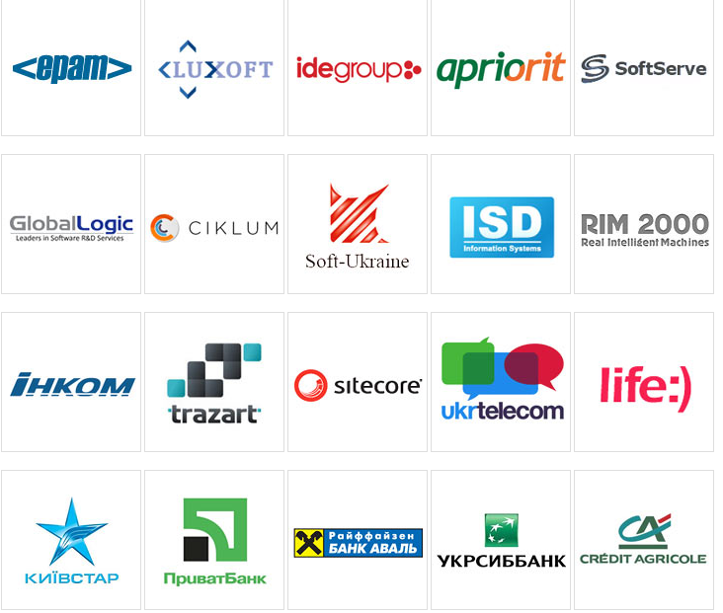
Involving employers
NMU team cooperated with more than 30 largest labor stakeholders of the INARM project of Dnipropetrovsk region.

Slide 14
Round tables with representatives of the professional market:
Company | Discussed topics, spheres of knowledge, learning outcomes concerning particular technologies.
Anadea Inc. | Web frontend, mobile programming. Particularly: Android, iOS, Java, Scala, Clojure, Ruby, Ruby on Rails, Ruby, Javascript, HTML5, Motion.
Apriorit – Ukrainian outsourcing and product company | Corporate safety, security and data analysis, virtualization and cloud computing, system of low-level decisions. Particularly: programming under Win32, Linux and Mac, as well as mobile OS-iOS, Android, Windows Phone.
Aquasoft – Ukrainian outsourcing company | CAD, CAE, CAM, PDM and PLM applications. Math. modeling, analytic geometry, 2D and 3D graphics, high-performance and parallel computing, engineering data management system of industrial products and engineering constructions.
Archer Software – American outsourcing company | Programmers working with Drupal, jQuery, Sinatra, iOS, .NET, Java, Rails, Android, MongoDB, NGINX.
Ciklum –Danish outstaffing and outsourcing company | .NET, C++, PHP frontend, Java, development of mobile applications.
Cupid PLC – Ukrainian-British company | Design of web sites (PHP/MySQL), widgets, mobile versions of sites, mobile applications for iOS, Android, Windows phone. Discussing specific peculiarities of an education of programmers and designers and engineers, product managers, analysts, bringing accent on the topics like internet marketers (PPC, Affiliate, SEO, SMM), Web Extras.
Dataart – American outsourcing company | Discussing needs in developers education concerning all mainstream technologies: Java, Scala, .NET, JavaScript, PHP, Ruby, Python, Android, iOS, DB, QA/QC.

Slide 15
Round tables with representatives of the professional market:
Daxx – Dutch no.1 outstaffing company | Discussing learning outcomes for specialist upbringing for the: solutions development based on Adobe technologies CQ and Hybris; desktop applications using Scala and .NET, accentuating on enterprise architecture; mobile (Android, iOS) applications; product based solutions (JIRA/Confluence).
Epam Systems – American outsourcing company | Discussing specialists’ upbringing in automation, business process architecture management, Web development, technologies: J2EE, .NET, Oracle, Java, C#, C++, VC++, C, Perl, PHP, Java Script, AJAX, HTML, XML, XSLT.
ilogos – Outsourcing company-game developer | Cross-platform, social, mobile applications. 2D and 3D scripting, programmers on HTML5, Unity 3D.
Luxoft – The Swiss outsourcing company | Analytical systems, systems of decision-making, developing CRM systems, ERP systems, web applications, authentication systems and mobile applications. Development of the back-end, front-end systems, mobile applications. Technologies: JAVA, JavaScript, C#, Objective-C, .NET, HTML, PHP, Perl, Erlang, SQL, noSQL (mongoDB, Riak, Hbase).
Maxymiser – American food company | Discussing competences needed for the specialists in high-loaded web-based application, Big Data, NoSQL technology, MS SQL, OLAP, ASP.NET, MVC, development and optimization of websites using JavaScript, HTML, CSS, DOM, AJAX, JSON, JSFrameworks, GIT.

Slide 16
Round tables with representatives of the professional market:
Playtika – Israel company-game developer | Discussing competences needed for the specialists in high-loaded web-based application, Big Data, NoSQL technology, MS SQL, OLAP, ASP.NET, MVC, development and optimization of websites using JavaScript, HTML, CSS, DOM, AJAX, JSON, JSFrameworks, GIT.
RubyGarage – Ukrainian outsourcing company | Competences for client-server applications under Win, iOS, Android and Web. Knowledge in Java, C#, ActionScript3, OpenGL, Xamarin, Spring Ioc, Flex, Starling.
Sitecore – The Danish food company | Technology know-how in Ruby on Rails and AngularJS. Knowledge of e-commerce, online education, services of advertising, social networking, tools for project management, etc.
SoftServe – Ukrainian outsourcing company | Technology skill stack discussion: .NET Framework: tools: ASP.NET, MVC, MongoDB, Jasmine (Unit testing), FxCop and Sonar (with metrics), Angular.js frameworks, backbone.js, knockout.js (for UI). Continuous Integration based on TFS with TeamCity, test automation based on Telerik Test Studio.
Yalantis – Ukrainian outsourcing and product company | Competences in mobile development, SaaS & Cloud, BI & Analytics, software architecture, UI AND UX, security.
WiX – Israel food company | Competences in mobile development under iOS and Android.
PrivatBank – Ukrainian largest bank network | Competences in cloud-based platforms, front-end languages like JavaScript; BI and DevOps: Java, Python, Ruby, Scala, technologies: AngularJS, ReactJS, Apache Hadoop, HBase, Apache Storm, Google Cloud Solutions; methodologies like TDD.

Slide 17
Round tables with representatives of the professional market:
Continual participation in meetings of IT-heads Club of Dnipropetrovsk (http://itdirector.org.ua/club/it_clubs/it_club_dnepr/).
14.08.2014 – discussing professional requirements for the young specialists to be able to implement IT projects remotely.
26.09.2014, 01.10.2014 – discussing requirements for specialists in information management and business IT architecture.
14.10.2014 – workshop with participation of Dnipropetrovsk regional administrative board and “Information Technologies of Ukraine association”. Issues of the formal and informal Education with stakeholders attraction.
15.04.2015 – discussion of joint curriculum in IT development by representatives of the professional labor market and higher educational institutes (both private and public).
01.07.2015 – round table concerning web-platform development for the stakeholders dialogue in IT specialists upbringing.

Slide 18
Our vision
Illustration by Hank Osuna, 2013

Slide 19
International setting
National context
Regional inclusion
Environment
Mission
Strategies
Specialties
University
Decision makers
Operators
Beneficiaries
Quality initiatives
Observation
Interviews
Document analysis

Slide 20
The roles and the authorities of the bodies in the system of formal education qualifications
Responsible authorities basic components (Features) | Ministry of Education and Science | School | Training school | Institutions of Higher Education | Quality Assurance Agency for Higher Education | Infant schools
The development of standards / qualifications | ✓ |  |  | ✓ | ✓
Agreements on standards / qualifications | ✓
Approval of standards / qualifications | ✓
Creation of assessment tools |  | ✓ | ✓ | ✓
Recognition of learning outcomes / assessment of competencies |  | ✓ | ✓ | ✓
Qualification (certification) |  |  |  | ✓
Programs accreditation |  |  |  |  | ✓
Accreditation of educational institutions | ✓
Monitoring of the activities of educational institutions |  |  |  |  |  | ✓

Slide 21
The roles and the authorities of the bodies in the system of formal education qualifications
Responsible authorities Basic components (Features) | Qualification agency | Ministry for Social Policy | Profiled / sectoral Сentral government | Professionally-sectoral councils | Training school | Institutions of Higher Education | Сenters of the evaluation / recognition of the training | Public organizations (professional associations) | Social partners (employers, trade unions)
The development of standards / qualifications |  |  | ✓ | ✓ |  |  |  | ✓ | ✓
Agreements on standards / qualifications |  | ✓ | ✓ | ✓
Approval of standards / qualifications | ✓ |  | ✓
Creation of assessment tools |  |  |  |  | ✓ | ✓ | ✓
Recognition of learning outcomes / assessment of competencies |  |  |  |  | ✓ | ✓ | ✓
Qualification (certification) |  |  | ✓ | ✓ |  |  |  | ✓ | ✓
Programs accreditation | ✓
Accreditation of educational institutions | ✓

Slide 22
Faculty ratings of student success technologies (Present Time)
Suggestions about new or different academic recourses for students
Alerts if it appears a student’s progress in a course is declining
Suggestions for how to improve performance in a course if a student’s progress is substandard
Personalized support and information on students’ progress toward their degree goal
Personalized quizzes, questionnaires oriented on students’ strength, weaknesses

Slide 23
Faculty ratings of student success technologies (Future Time)
Personalized dashboards that provide real-time feedback about their progress in the course
Personalized guidance about courses student may consider to take in the future

Slide 24
Institution-wide deployment of student planning and advising systems
Degree accreditation
Advising center management
Academic early alerts
Education plan design and tracking
Course & program recommendations

Slide 25
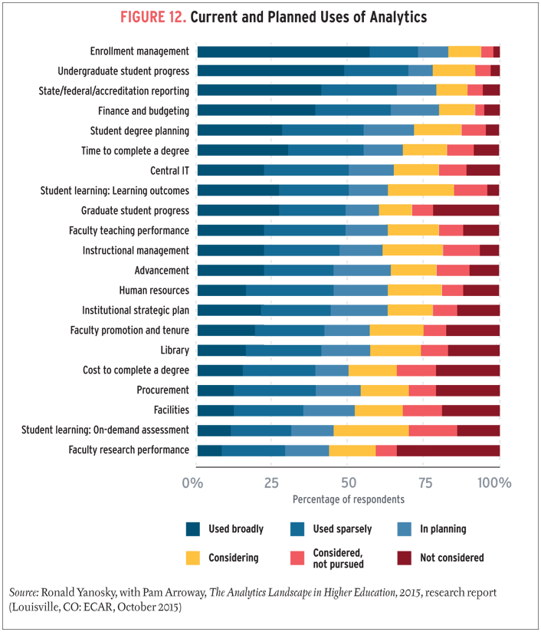
Analytics: student engagement, individual student learning, for student success

Slide 26
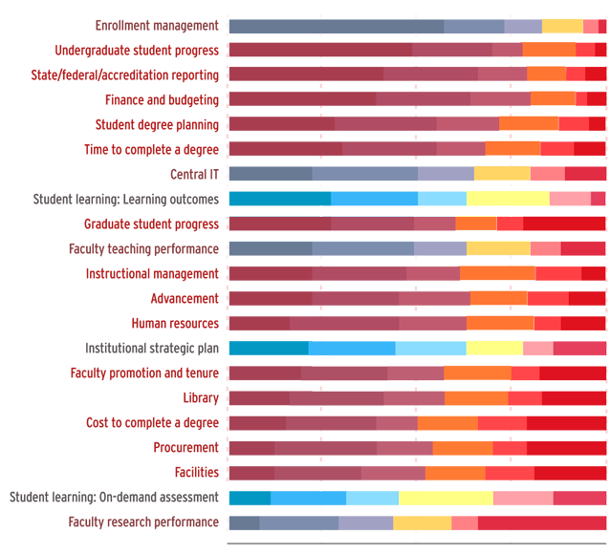
Analytics: student engagement, individual student learning, for student success

Slide 27
QA Mechanisms
External
Internal
National level
Institutional level
Compound level
Quality assessment:
1. Evaluation \ assessment
2. Accreditation (visitation)
3. Audit
4. Benchmarking
Stakeholders:
1. Government
2. Students
3. Employers
4. HEI
5. QA Agencies

Slide 28
Gap analysis
Illustration by Hank Osuna, 2013

Slide 29
Curriculum Guidelines for Undergraduate Degree Programs in Computer Engineering
Necessity in LOs system theory
«More and more often employers accentuate their needs in staff “ability to meet complex demands successfully or to carry out an activity or task”. This demand-oriented or functional definition corresponds not just to a narrow professional skills but to the combination of interrelated cognitive and practical skills, knowledge, motivation, values and ethics, attitudes, emotions, and other social and behavior components that together can be mobilized for effective action in a particular context.»

Slide 30
Necessity of the quick respond on new technologies arise
"Programmers by disposition are enamored of technology. This is a strength when it comes to abandoning old, inefficient ways and adopting new, more efficient ways. But it's a weakness when new software tools arrive faster than we can learn to use them effectively and we spend too much time at the wrong end of their learning curves. The benefits of a truly effective new technology are foregone when, in the rush to try out the next shiny whiz-bang tool, we abandon the current one.“
Scott Guthrie - From an interview published in Dr. Dobb's Journal

Slide 31
Programming Language of the year by TIOBE
2015 Java
2014 JavaScript
2013 Transact-SQL
2012 Objective-C
2011 Objective-C
2010 Python
2009 Go
2008 C
2007 Python
2006 Ruby
2005 Java
2004 PHP
2003 C++

Slide 32
Лабораторные индивидуальные занятия | Учебные групповые проекты | Коммерческие проекты
Программа создается одним человеком | Проект – создается группой программистов | Проект создается группой программистов
Дизайн исходного кода, деление на модули произвольны | Дизайн исходного кода и деление на модули регламентируется стандартами программирования, используемыми командой разработчиков | Дизайн исходного кода и деление на модули регламентируются стандартами программирования, используемыми совместной командой разработчиков и заказчиков проекта
Программа создается для одной текущей задачи, на одном компьютере | Проект создается для одной текущей задачи, запускается на нескольких компьютерах. | Проект создается для клиента, используется на разных компьютерах. Задача, поставленная в начале, может существенно измениться в процессе работы.

Slide 33
Лабораторные индивидуальные занятия | Учебные групповые проекты | Коммерческие проекты
Работа над программой не имеет продолжения и развития | Работа над программой не имеет продолжения и развития | Программный продукт корректируется и сопровождается
Исходный код может быть понятен только автору | Исходный код и внешний интерфейс модулей и классов, а также комментарии должны быть понятны и удобны для других разработчиков проекта | Исходный код и внешний интерфейс модулей и классов, а также комментарии должны быть понятны и удобны для других разработчиков проекта и пользователей
Программа не требует развитого интерфейса и специального оформления | Проект не требует развитого интерфейса | Проект требует хорошо продуманного и проработанного интерфейса, специального оформления.

Slide 34
Лабораторные индивидуальные занятия | Учебные групповые проекты | Коммерческие проекты
Программа не требует обработки исключительных случаев | Проект не требует учета, анализа и обработки исключительных случаев | Проект должен быть защищен от некорректных действий пользователя, должен обеспечивать обработку ситуаций нехватки памяти, ошибки работы с файлами и прочие некорректные события

Slide 35
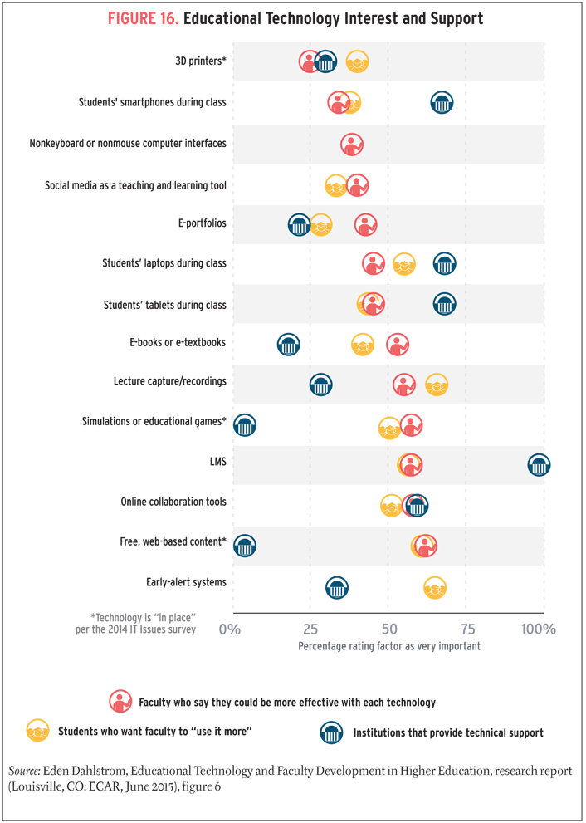
Educational technologies interest and support

Slide 36
Present-day world
Toolset
eScience
Big Data
Social Networks Crawling
Сomputer Modelling
Social Computing
eKnowledge
Methods of data “extraction”, modelling and forecasting
Principals, beneficiaries of researchers: society.
eParticipation
Government
eSociety
QA Institutions
eParticipation & Crowdsourcing (Open Data & Monitoring)
Public organizations
Labor market
University
Educational, expert networks
Graduates, educational specialists, scientists

Slide 37
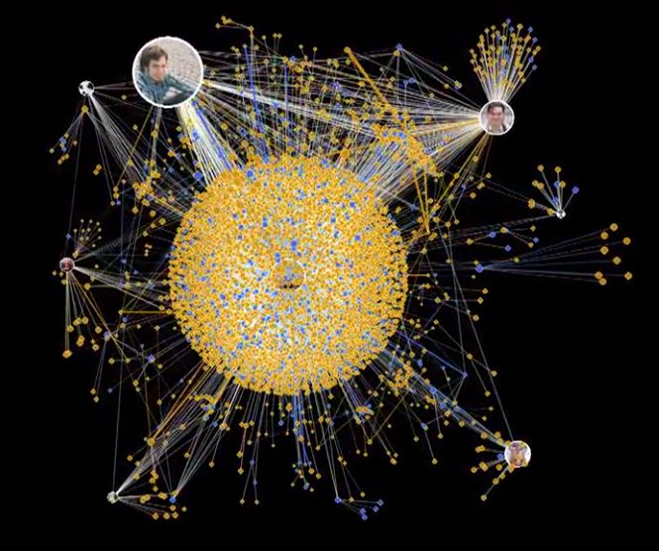
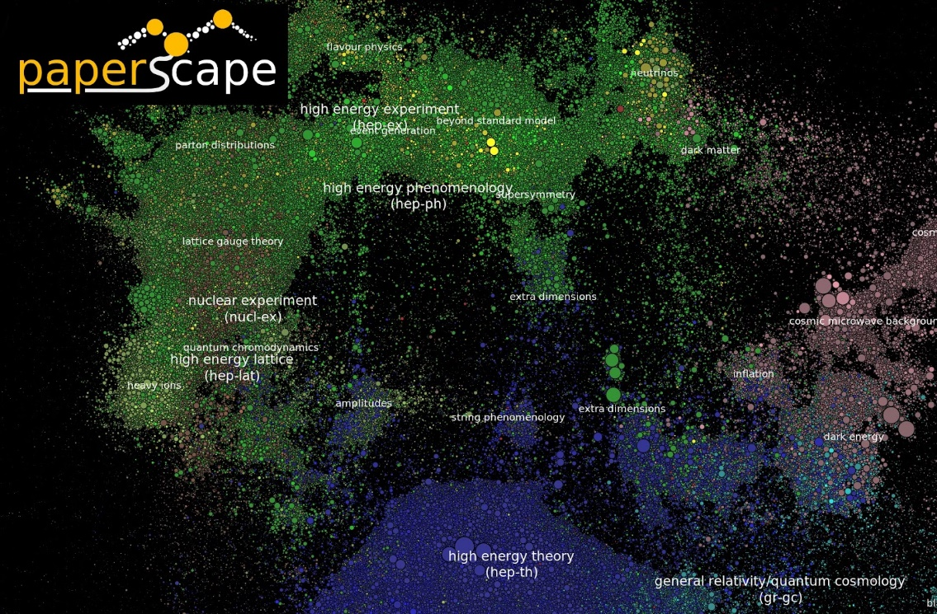
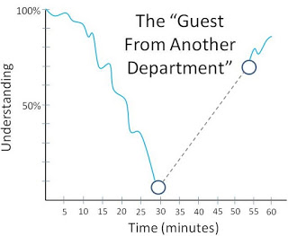
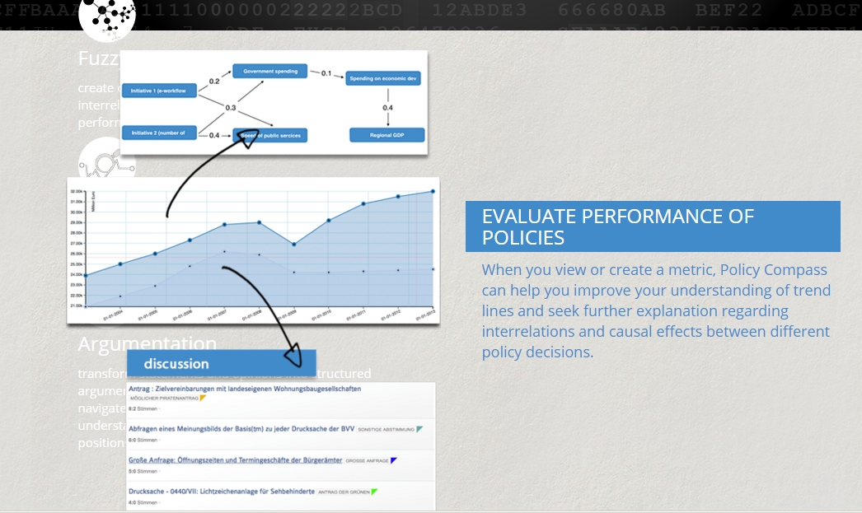
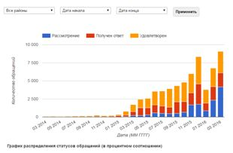
Tools
Social media analysis
eParticipation monitoring (open data analysis)
Sociological opinion polls
Casual maps method (e.g. Policy compass project)
Methods of indeterminate problems solving

Slide 38
Experience
Illustration by Hank Osuna, 2013

Slide 39
Achieved TEMPUS results
Development of the assembled model taking into account professional and educational descriptors, main official (QF related) essences in the scope of view of the theory of sets.
Development of the methodology of educational SQF and SQS design concerning software and data architecture also.
Development of the web platform for optimizing methodologist’s desktop while NQF, SQF, SQS design (http://inarm-temp.herokuapp.com/).
Development of pilot SQF in IT.

Slide 40
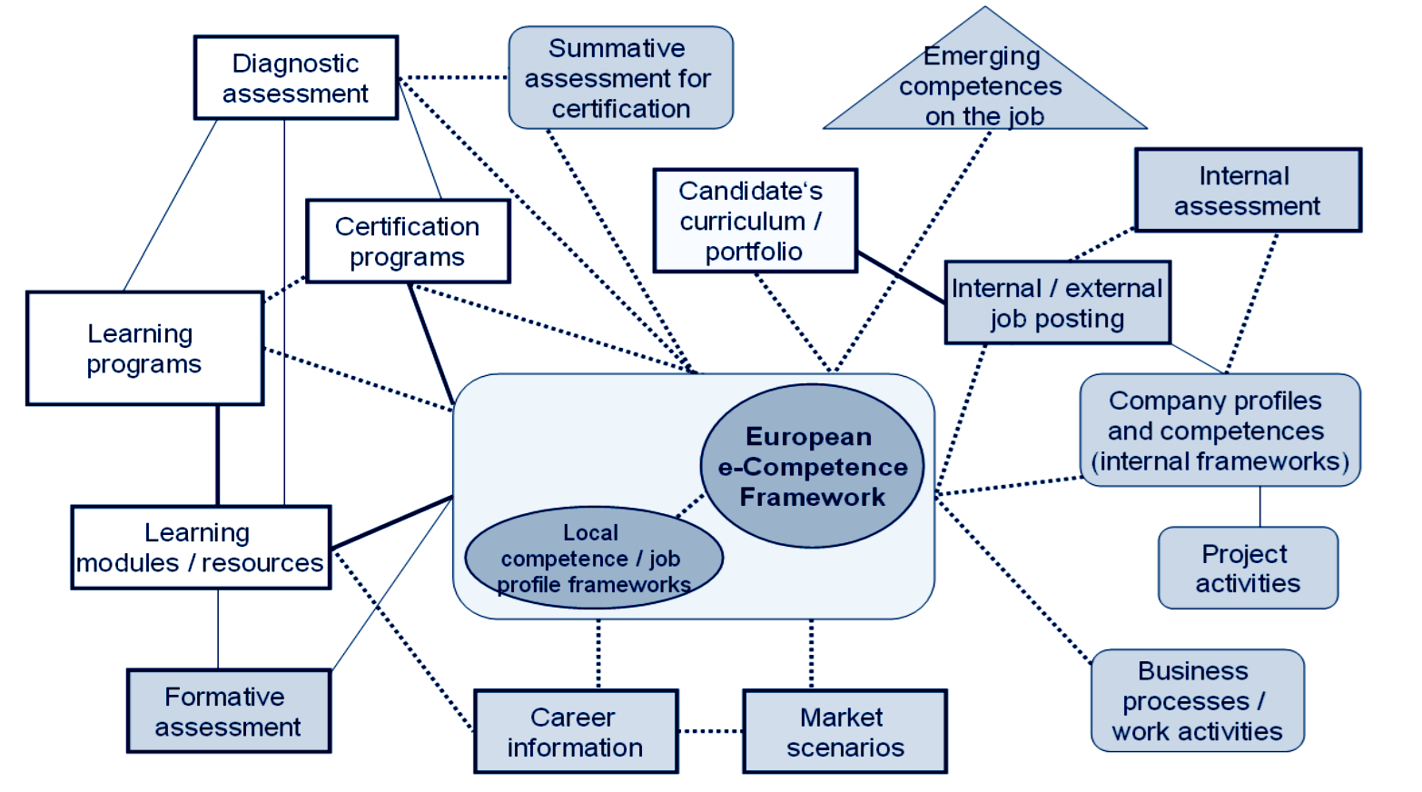
Aligning experiences
Common language of the information exchange

Slide 41
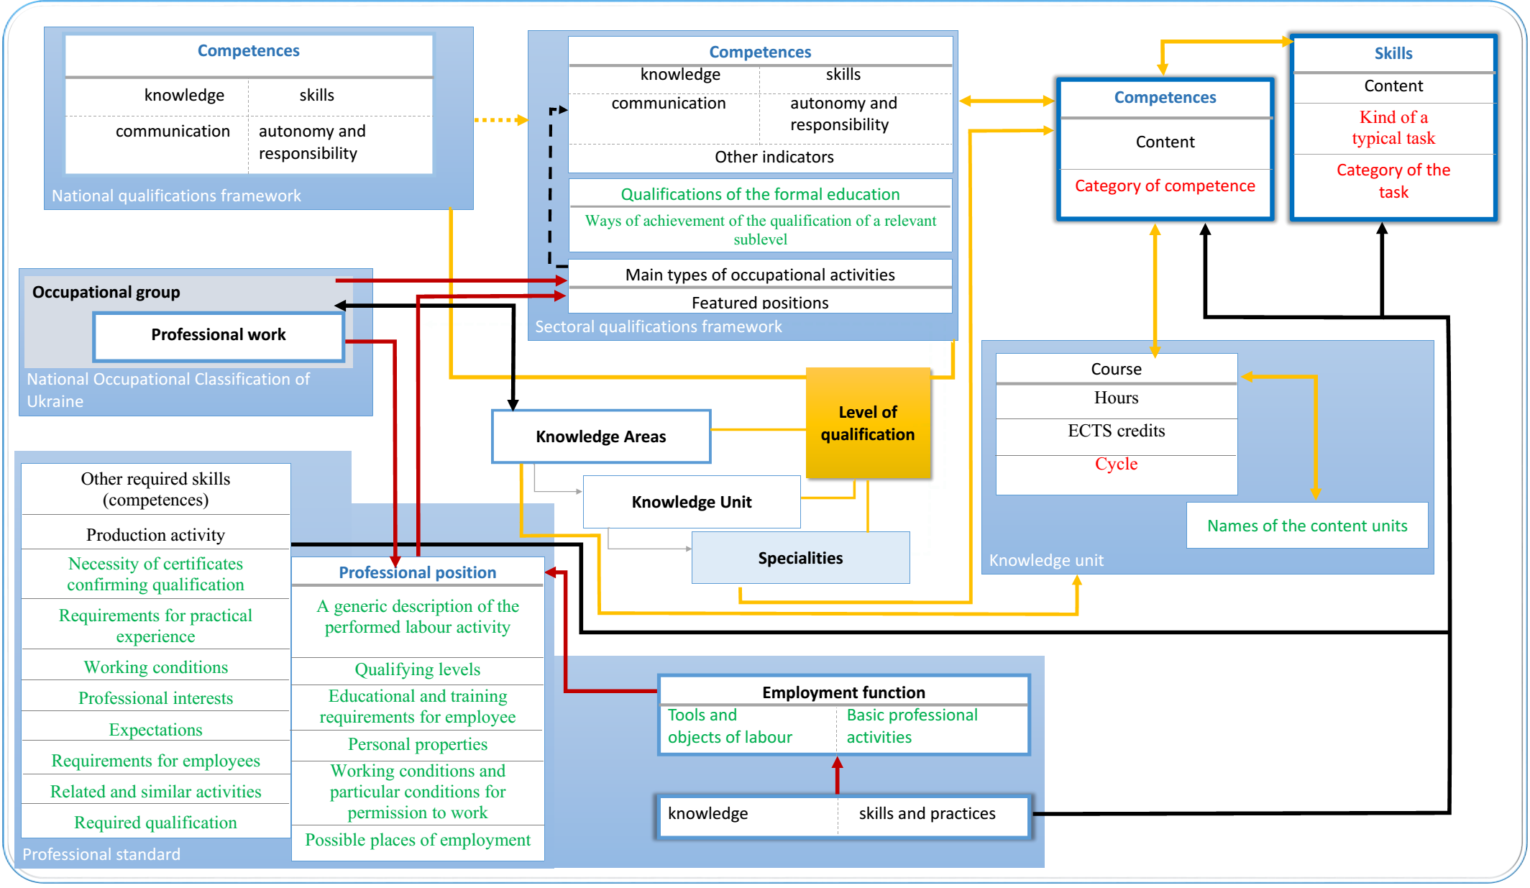
General Data architecture

Slide 42
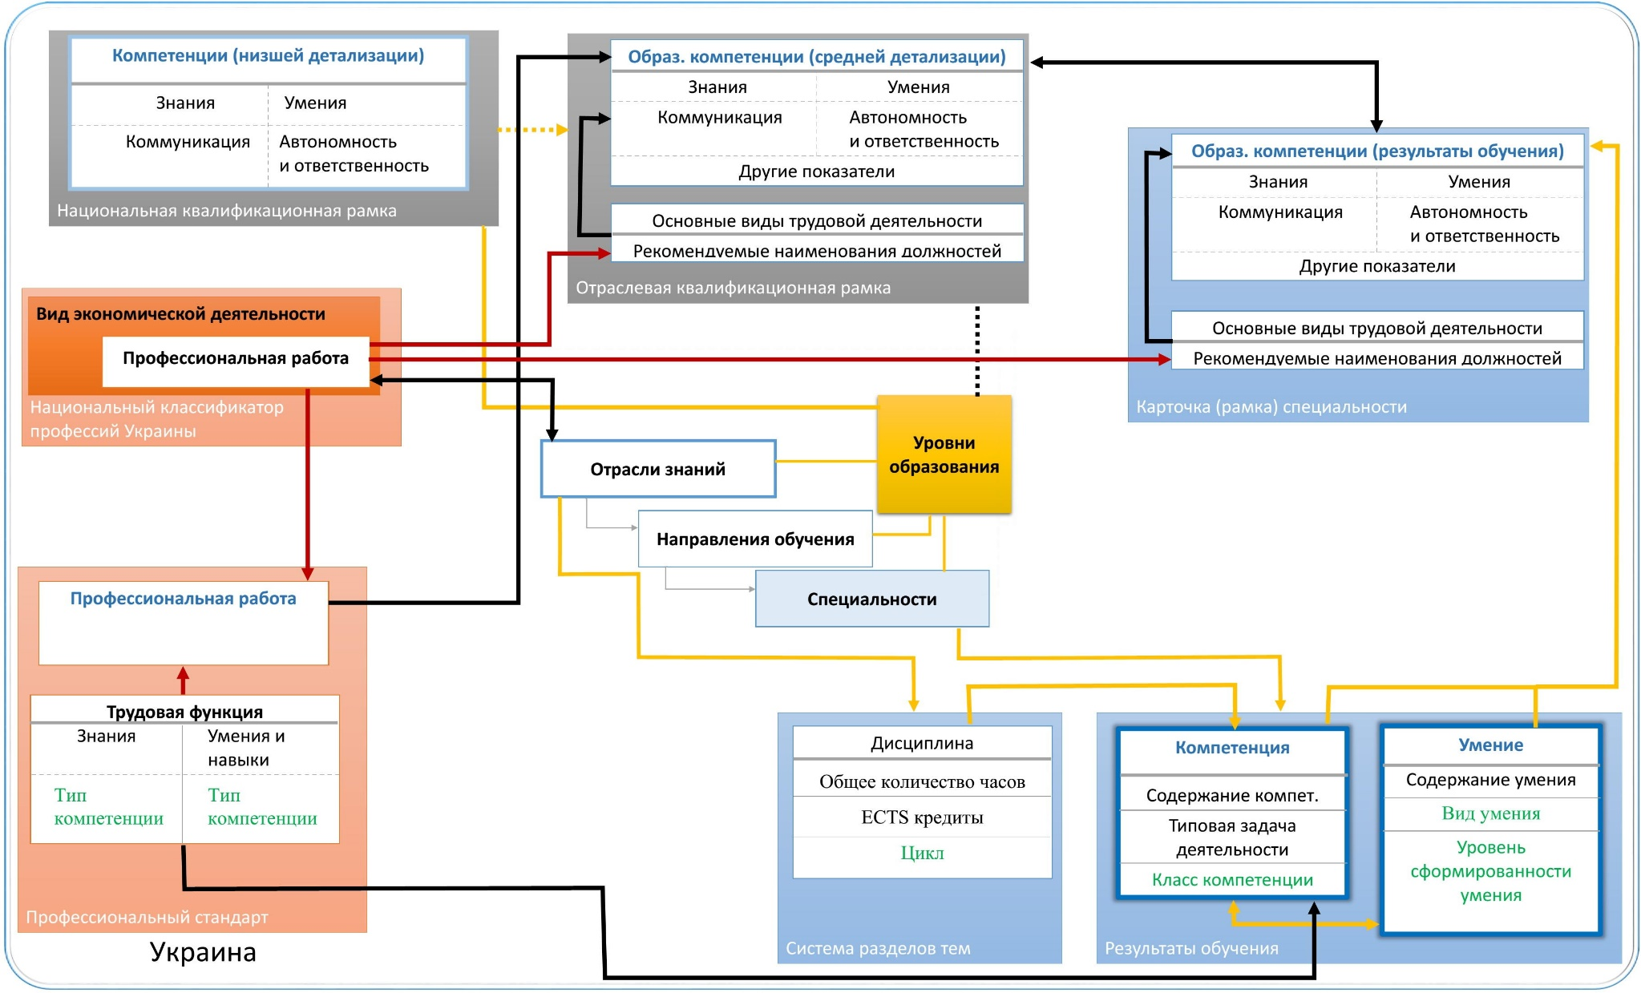
Data model for Ukraine

Slide 43
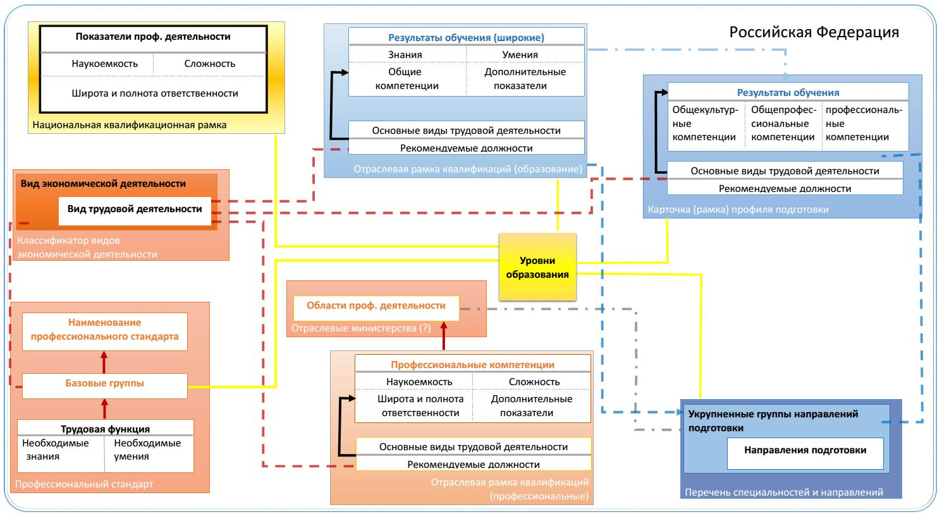
Data model for Russian Federation

Slide 44
On the basis of Ukrainian education architecture analysis, analysis of national standards, a web-based platform proposing users to interact with all main entities of the Ukrainian competence system was developed. It completely covers: EQF, NQFs, qualification levels and requirements, SQFs, SQSs, professional standards, curricula, learning outcomes. Purpose of the system - optimization of the methodologist’s desktop while design and fulfilment of sectorial frameworks and subframeworks. Developed tools allow stakeholders to reconsider and timely adjust professional and educational standards, and thus deliberately influence the quality of education, promoting the competitiveness of labor force, increasing human capital.

Slide 45
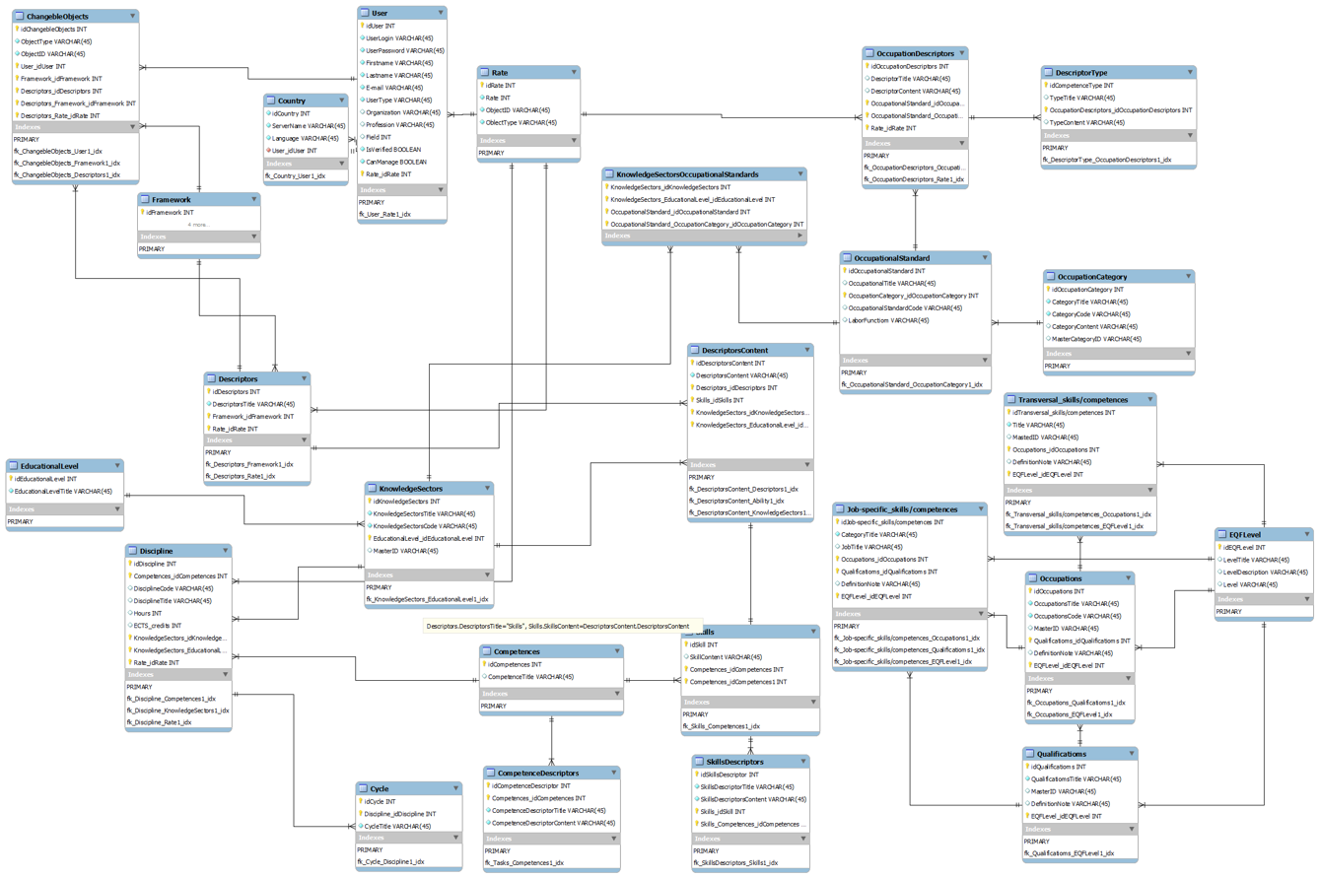
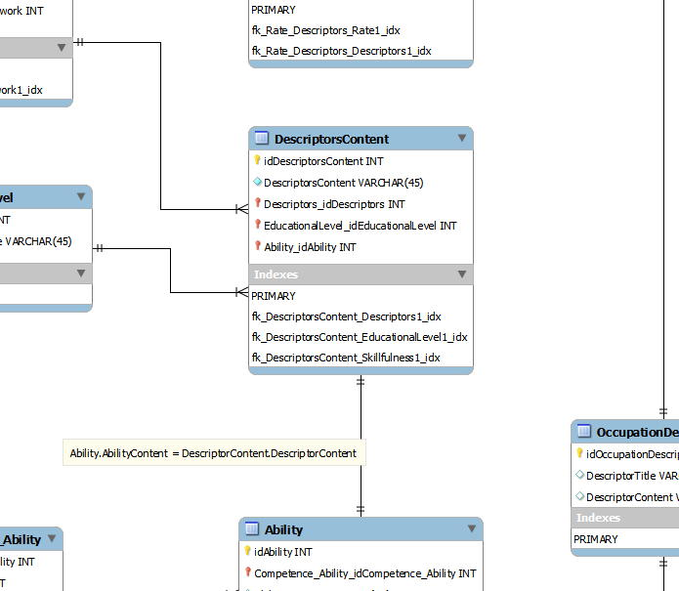
Database blueprint

Slide 46
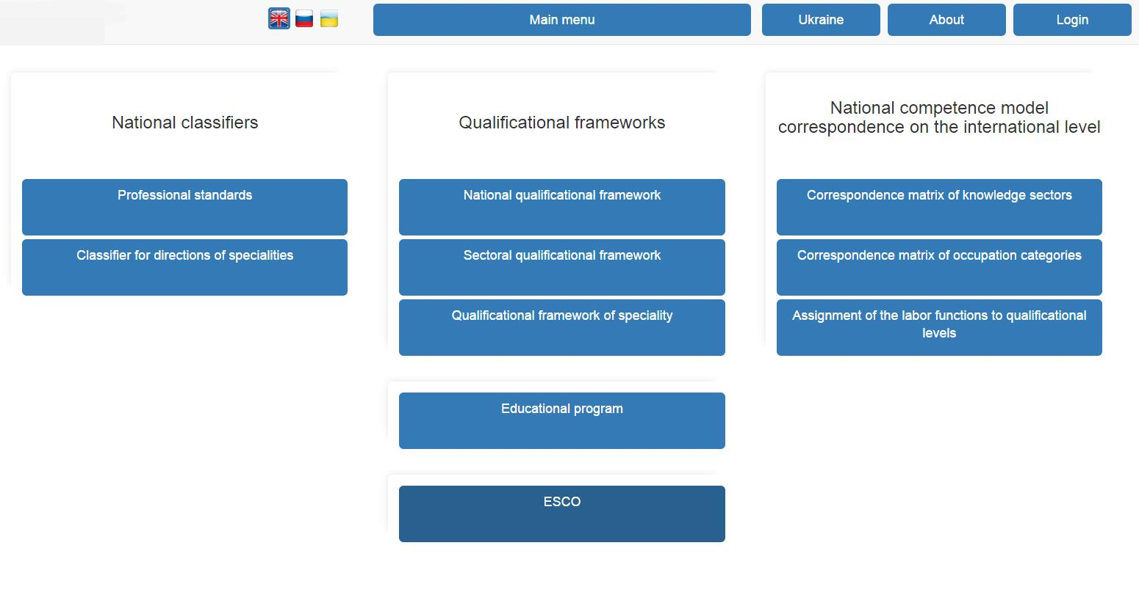
Software realization

Slide 47
Platform interfaces
1) Professional, labor market:
a) Matching lists of economic activities and professional positions.
b) Editing data concerning professional positions.
c) Editing data concerning job functions.
2) National Qualifications Framework of Ukraine page.
3) Academic, university staff:
a) The qualifier of educational branches, specialties.
b) Curriculum design.
4) Interconnection between units related to education and professional spheres:
a) Matching economic activities and branches of knowledge.
b) Matching labor functions and qualification levels.
c) Matching typical labor tasks, professional competences and professional standards.
d) Matching educational skills, professional skills and abilities.

Slide 48
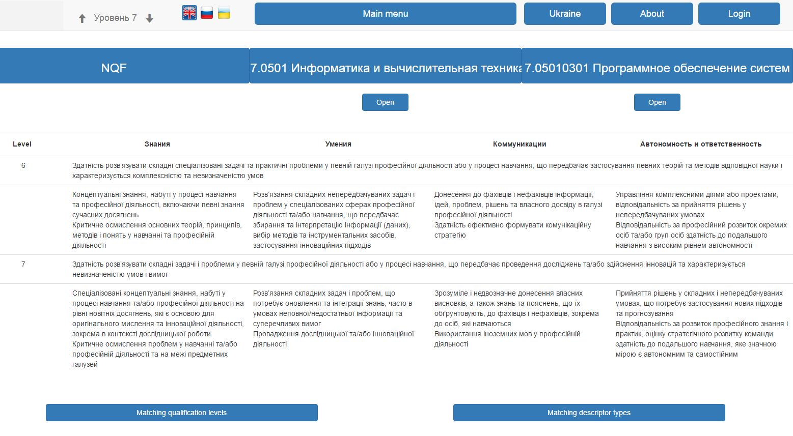
Software realization

Slide 49
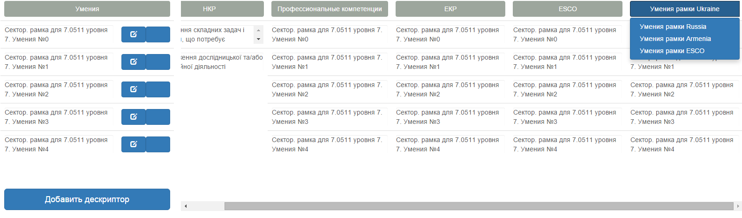
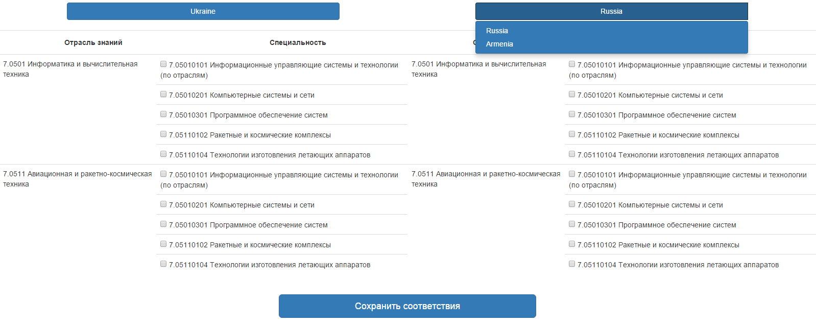

Slide 50
Founding principle
Surveys must be person-friendly
Questionnaires must not be never-ending list of questions, should be relevant exactly to the respondent’s interests and experience.

Slide 51
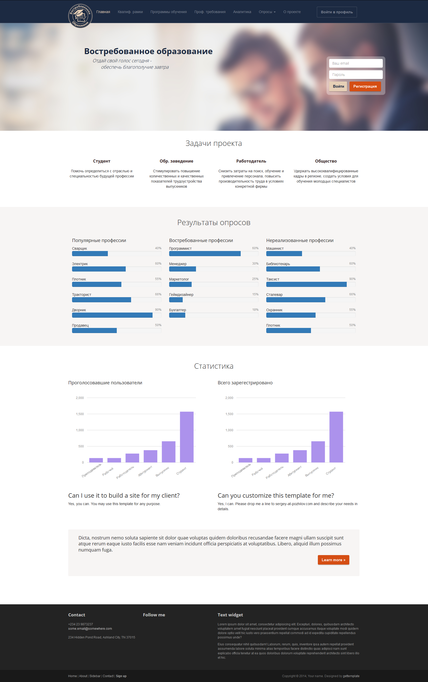

Slide 53
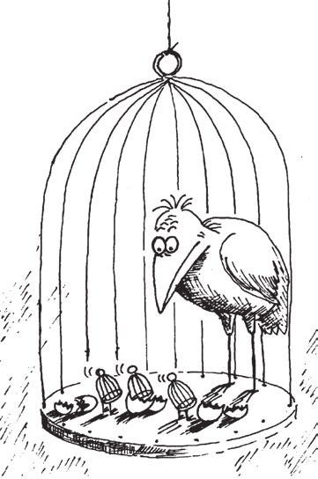
Quality control should protect both education and tutors who transmit this education but not to suppress them!

Slide 54

Many thanks for your attention!

